Slide 1


PADMAVANI ARTS & SCIENCE COLLEGE FOR WOMEN AUTONOMOUS
(Affiliated to Periyar University, Salem) Accredited by NAAC with A+ Grade (CGPA 3.44) & Cycle 2
Department of computer science & computer application
Bachelor of computer application
C.DHARANI (Reg.no 24PVUCA007)
S.SATHYAPRIYA(REG.NO 24PVUCA019)

Slide 2
~AI BASED SPAM E-MAIL DETECTION~ . SYSTEM .

Slide 3
ABSTRACT
Email spam is increasing rapidly with the growth of internet users.
Spam emails may contain malicious links that can harm our systems.
Machine learning helps detect and filter spam emails automatically.
This project identifies spam emails using machine learning techniques.

Slide 4
EXISTING SYSTEM
Uses predefined rules and known patterns to detect spam and phishing emails.
Rules are created based on keywords, sender domains, and message patterns.
Works well for known threats, but may fail to detect new or zero-day attacks.

Slide 5
PROPOSED SYSTEM
An AI-based email security system that detects spam and phishing threats.
Emails pass through a four-layer security pipeline for better protection.
Combines AI analysis and firewall protection to detect sophisticated threats.

Slide 6
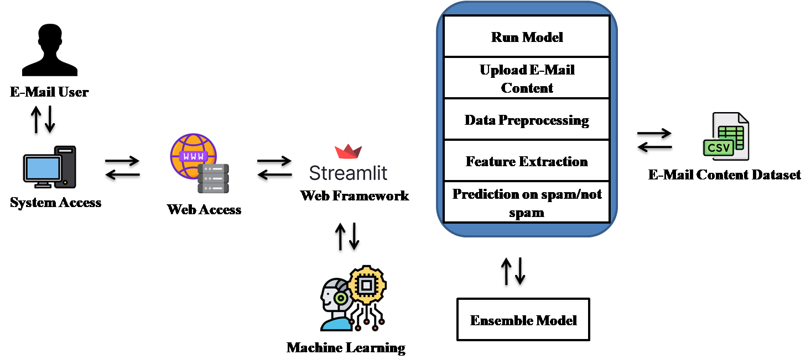
SYSTEM ARCHITECTURE

Slide 7
SOFTWARE SPECIFICATION
HARDWARE REQUIREMENTS:
System : Pentium IV 2.4 GHz.
Hard Disk : 500 GB.
Monitor : 15 VGA Color.
Mouse : Logitech.
RAM : 4 GB.
SOFTWARE REQUIREMENTS:
Operating System : Windows-10/11 (64-bit).
Frontend : Streamlit 3.6
Backend : Python 3.10 (64-bit)
Dataset : E-Mail Content Dataset (CSV)
IDE Tools : Visual Studio Code 1.8 (64-bit)

Slide 8
MODULES
Data Collection and Preprocessing Module
Feature Extraction Module
AI Model Selection and Implementation Module
Deployment and Continuous Learning Module

Slide 9
DATA COLLECTION AND PREPROCESSING MODULE
FEATURE EXTRACTION MODULE
*The quality of training data is important for building an effective AI model.
*The dataset contains emails labeled as Spam or Ham (legitimate).
*Dataset details help ensure accuracy and transparency in the research.
*Feature extraction converts text into numerical data that machine learning models can understand.
*Naive Bayes and SVM use TF-IDF,
*while Neural Networks use word embeddings
such as Word2Vec and GloVe.

Slide 10
AI MODEL SELECTION AND IMPLEMENTATION MODULE
In this comparative evaluation, a single instance of three different AI models was selected to illustrate the range of text classification methods that vary in complexity and capability: Naive Bayes, with KNN design, Support Vector Machine (SVM), with hyper parameterization specifying the selected kernel and C value in SVC.
SVMs are well-suited to high-dimensional feature spaces, typical of data derived from text, and are less susceptible to overfitting.

Slide 11
Sample output
______________________________________________

Slide 12
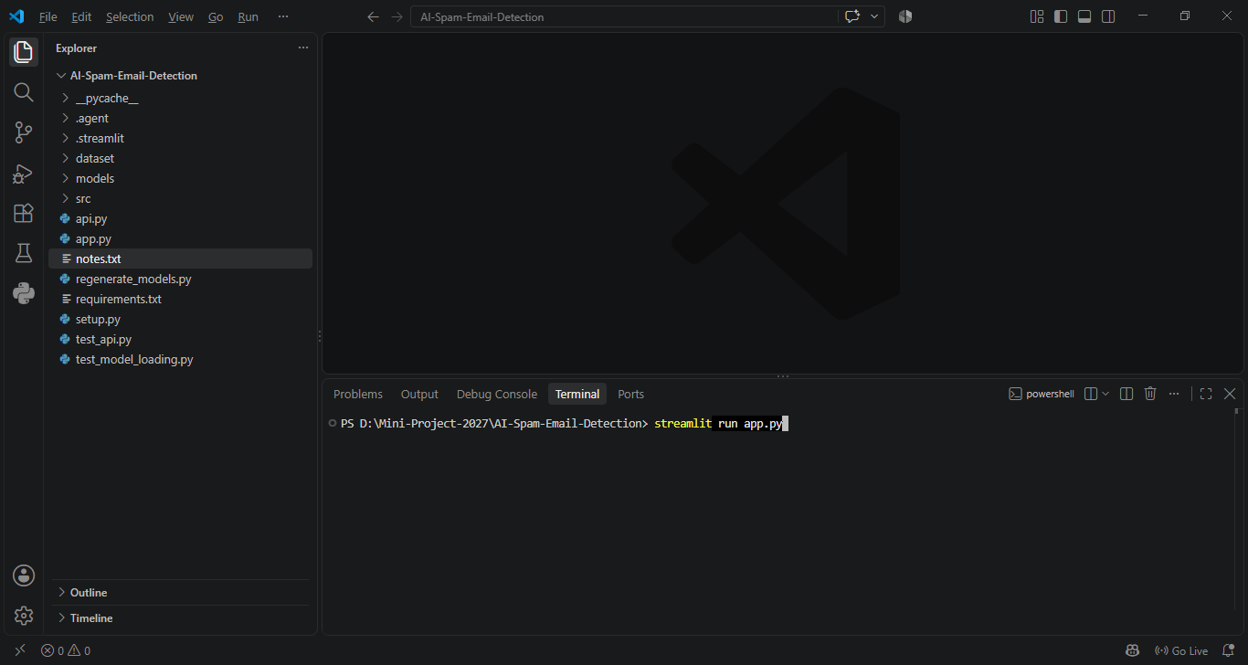
Run Streamlit Command

Slide 13
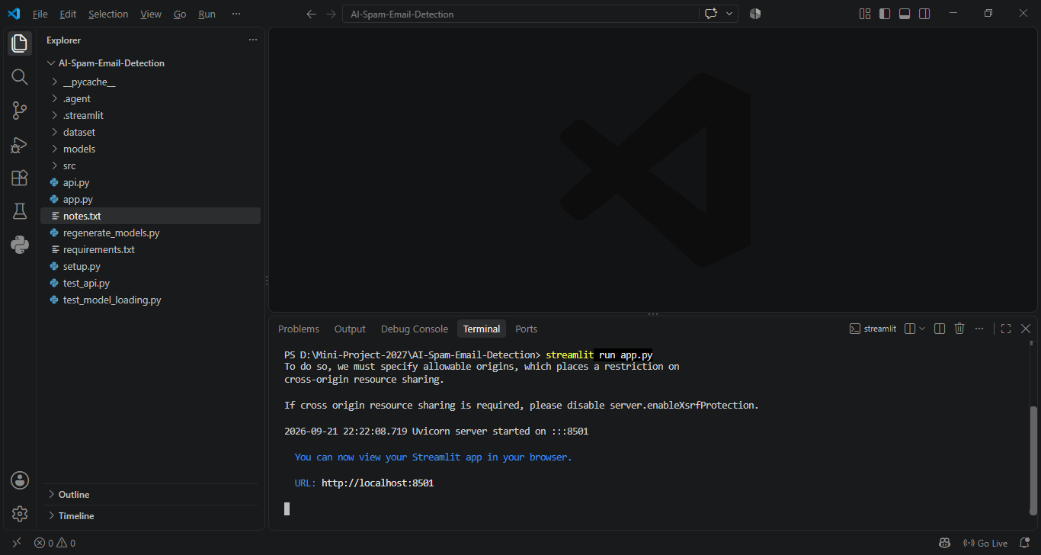
View Web Host Link

Slide 14
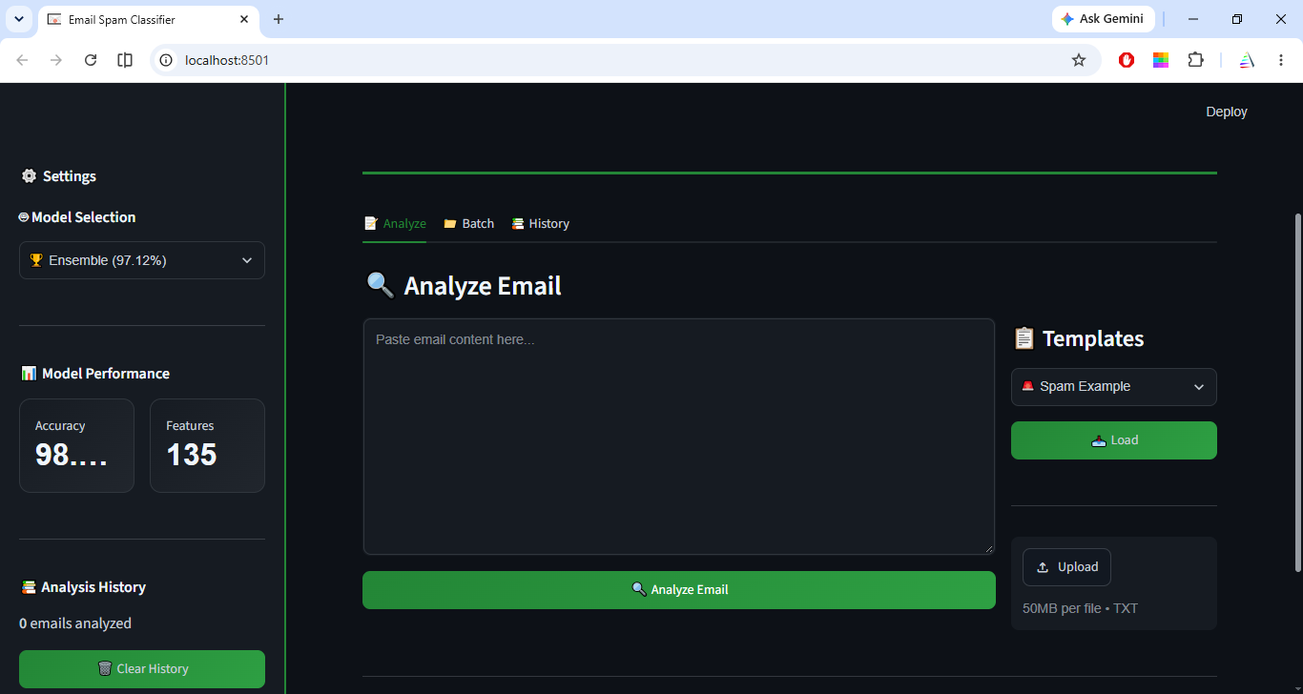
Dashboard

Slide 15
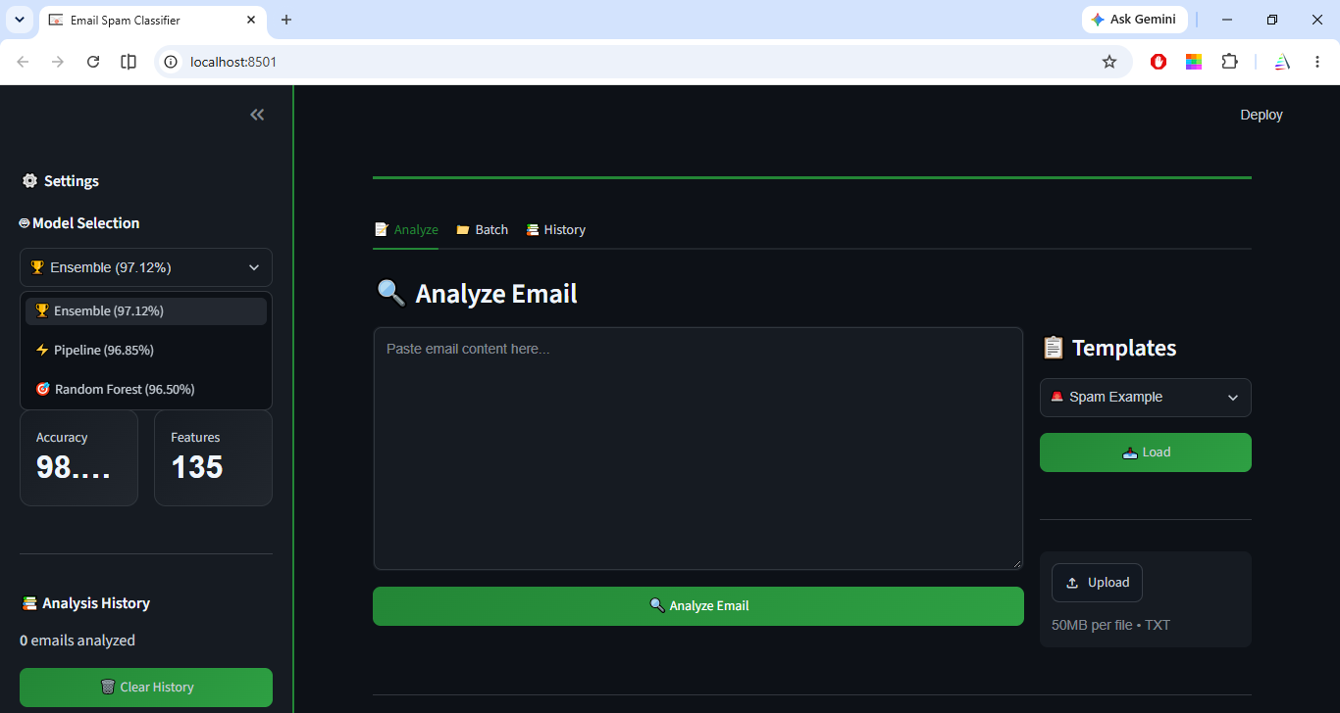
Select Model

Slide 16
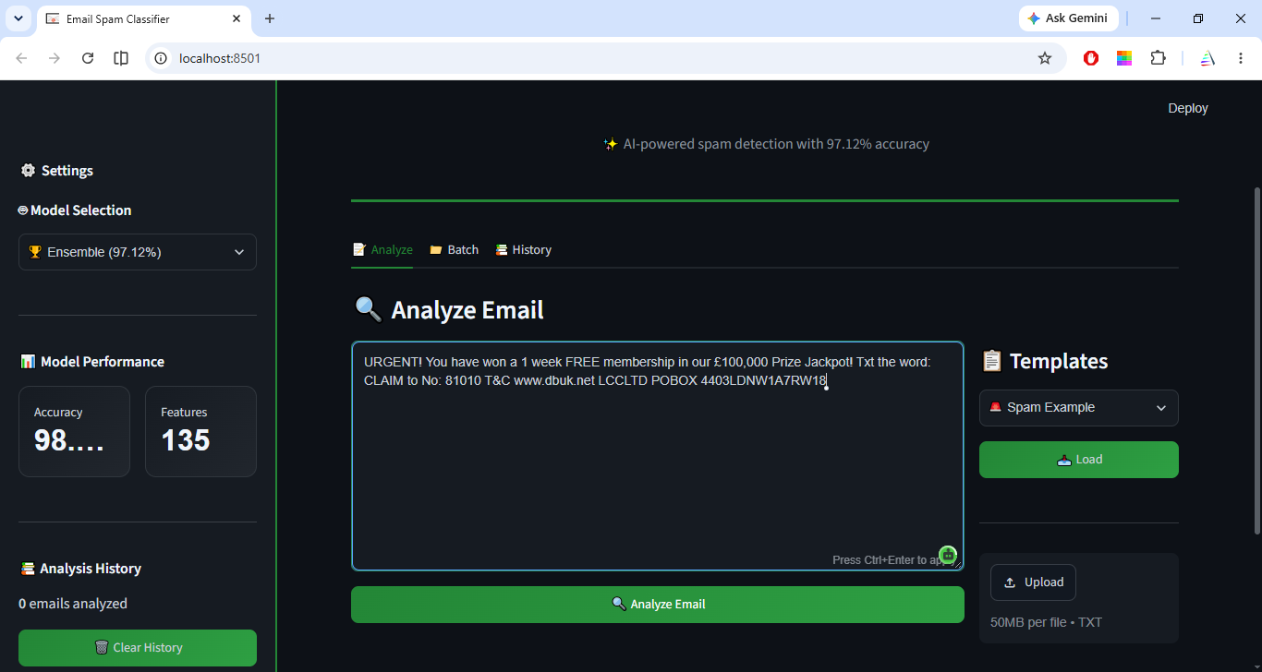
Upload E-Mail Content

Slide 17
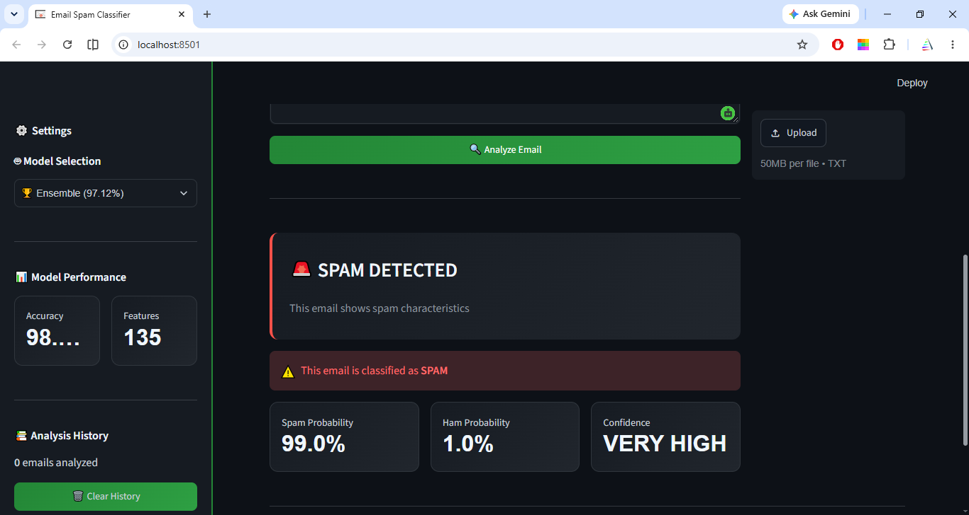
Analyze E-Mail Result

Slide 18
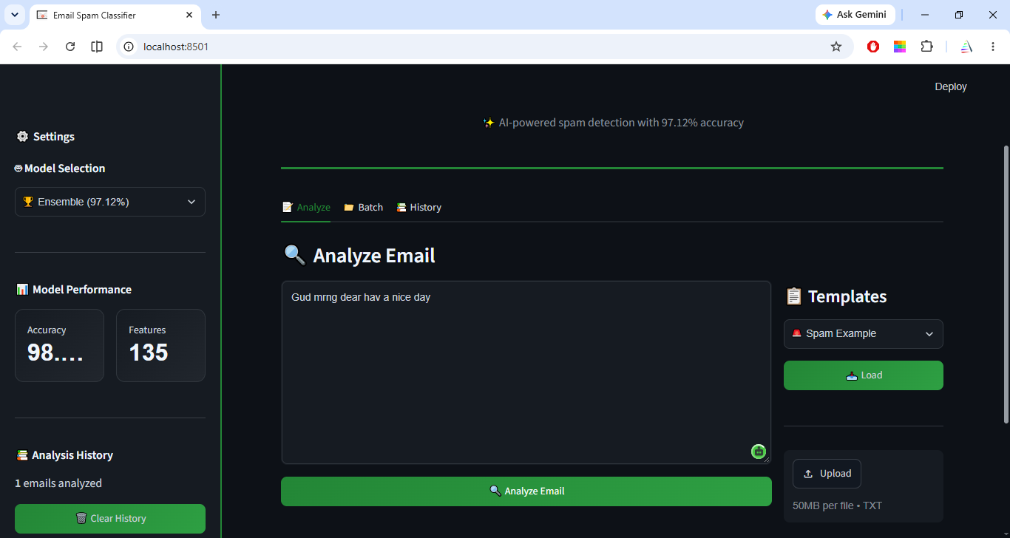
Another E-Mail Content

Slide 19
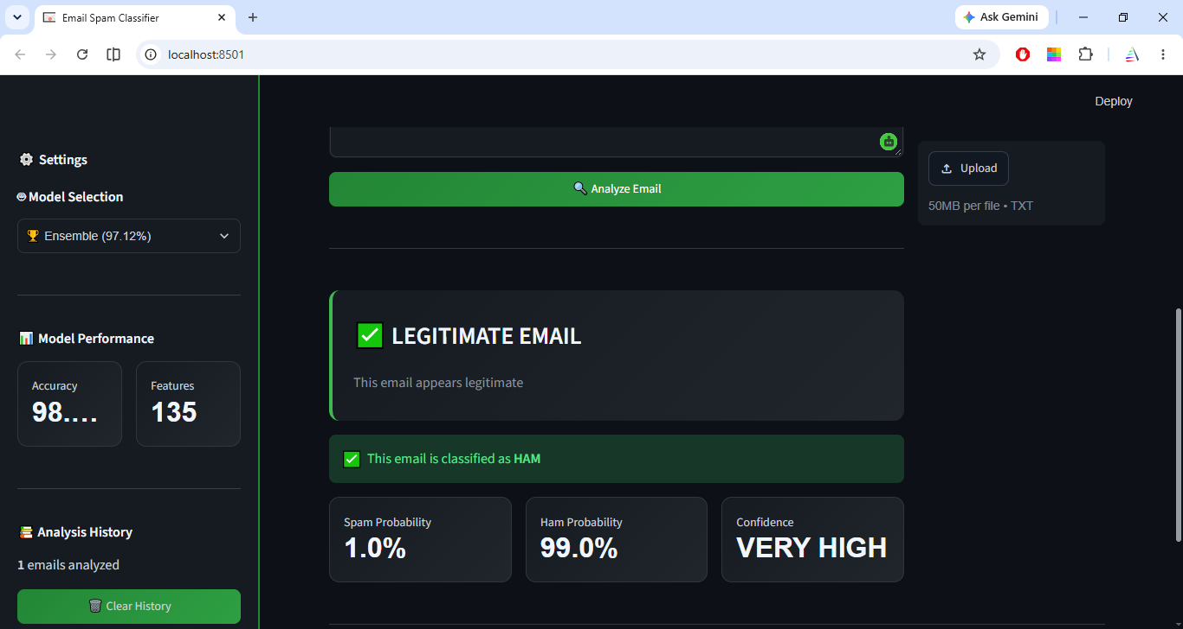
Analyze E-Mail Result

Slide 20
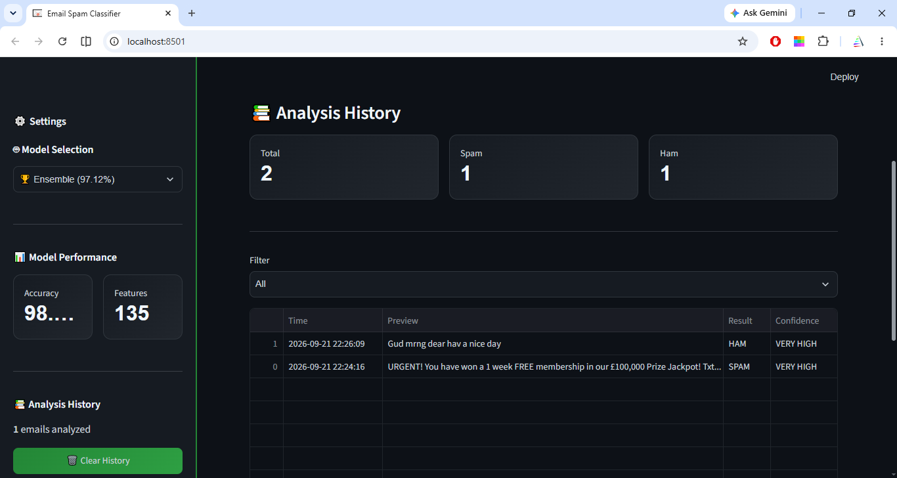
Analysis History

Slide 21
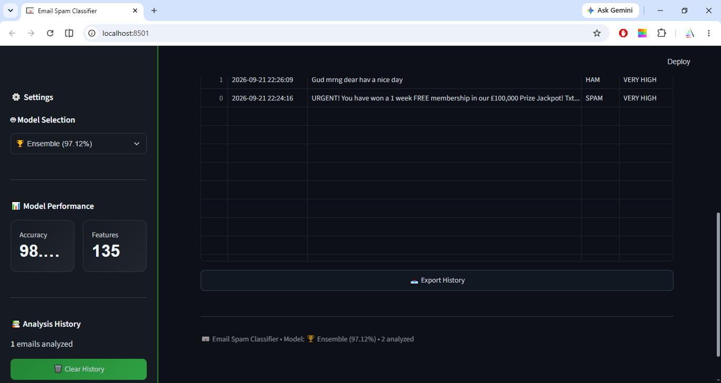
Export History

Slide 22
CONCLUSION &
FUTURE WORK
*AI and machine learning help detect and remove unwanted spam emails.
* Emails are classified as Spam or Ham based on their content and features.
* Accuracy and performance metrics are used to evaluate the system.
*Recipient details and file metadata can be added to improve detection.
*The system can support multi-class email classification for better accuracy.
*This approach is useful for corporate and medical email systems.

Slide 23
THANK YOU

